Slide 1
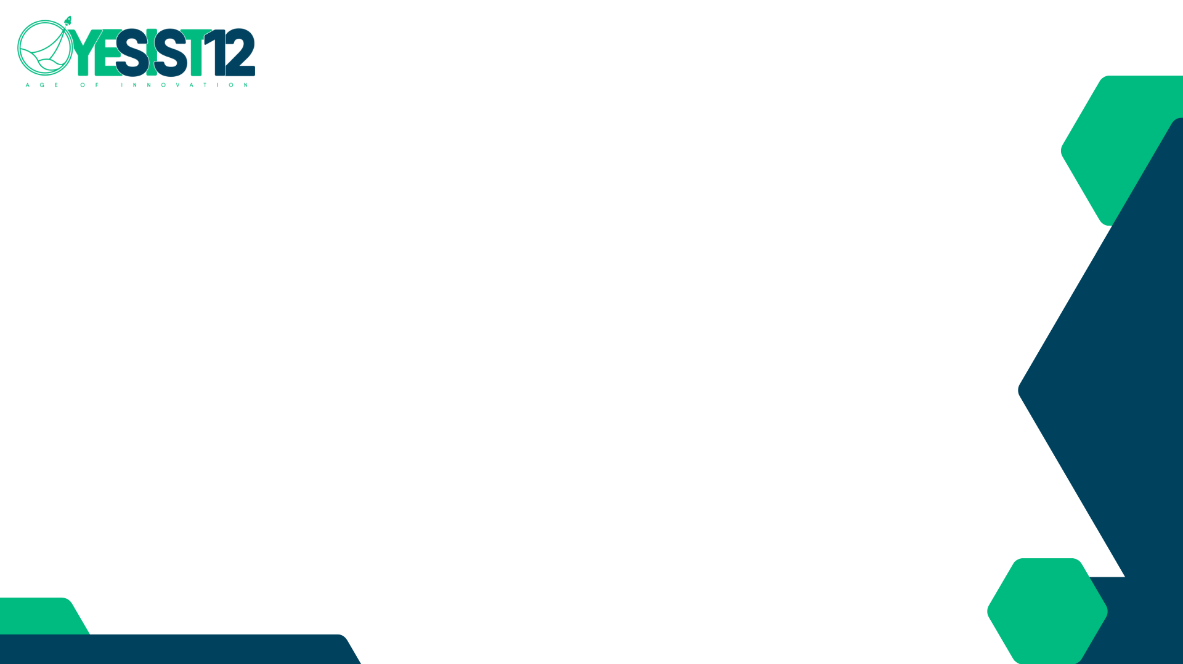
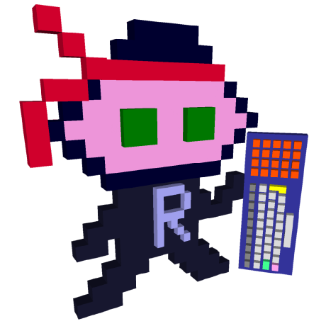
Team Name: Roten.X
Project Name: Mute Voice

Slide 2
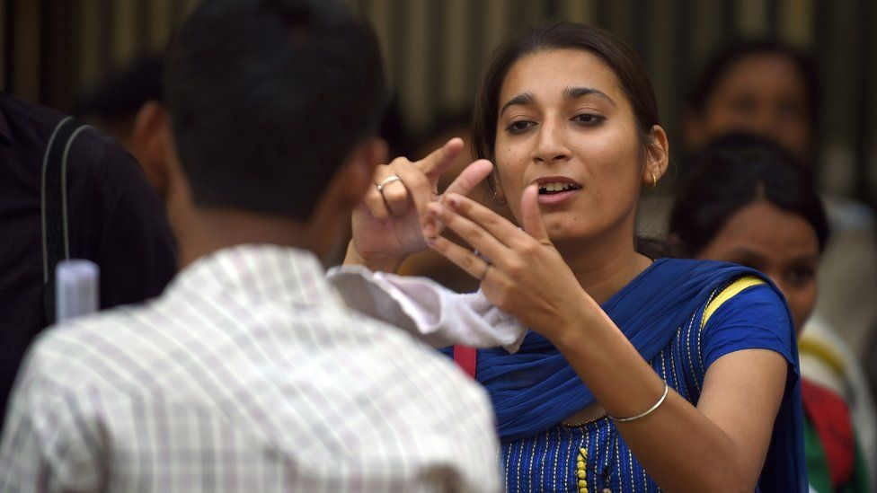
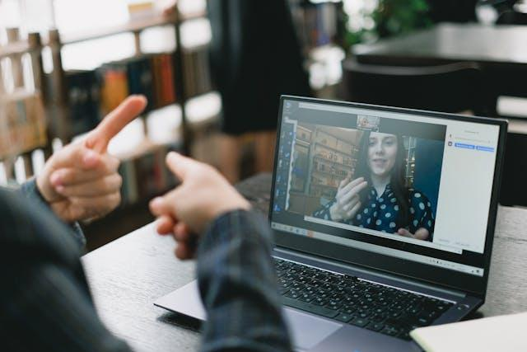
Problem Statement:
Across the globe, over 70 million people live with speech impairments, and they’re often pushed aside because they don’t communicate like the rest of us. Sign language is their primary mode of communication, but most people don’t bother to learn it, leaving them voiceless and isolated. Imagine the frustration and isolation they face daily, just trying to meet basic needs, relying on text messages or hoping someone nearby understands sign language. This is a problem we can no longer ignore

Slide 3
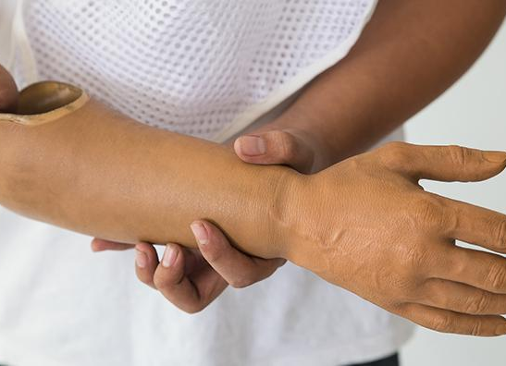
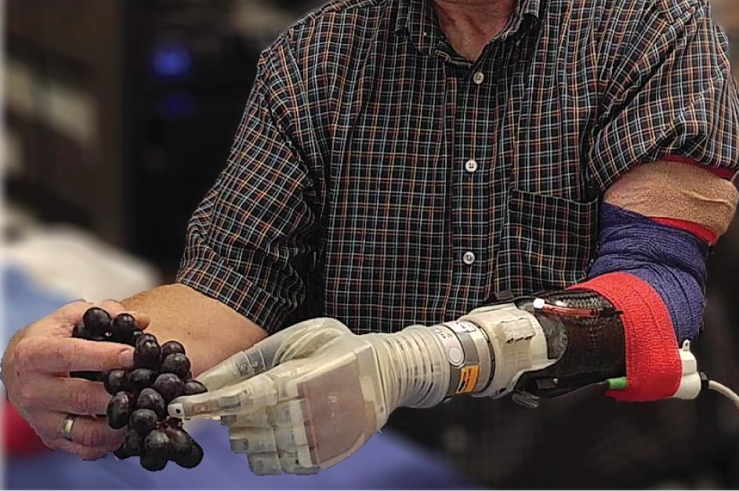
Problem Statement 2:
Now, let’s turn our attention to prosthetics. Between 35 to 40 million people worldwide are living without functional hands, yet most prosthetic solutions available today are shockingly inadequate. They offer basic movements like forming a fist or moving the wrist, but they fail to restore what’s truly needed—independent finger control. Millions of people are left with stiff, unresponsive devices that don’t let them regain full independence. This isn’t just a challenge; it’s a call to action for better solutions.

Slide 4
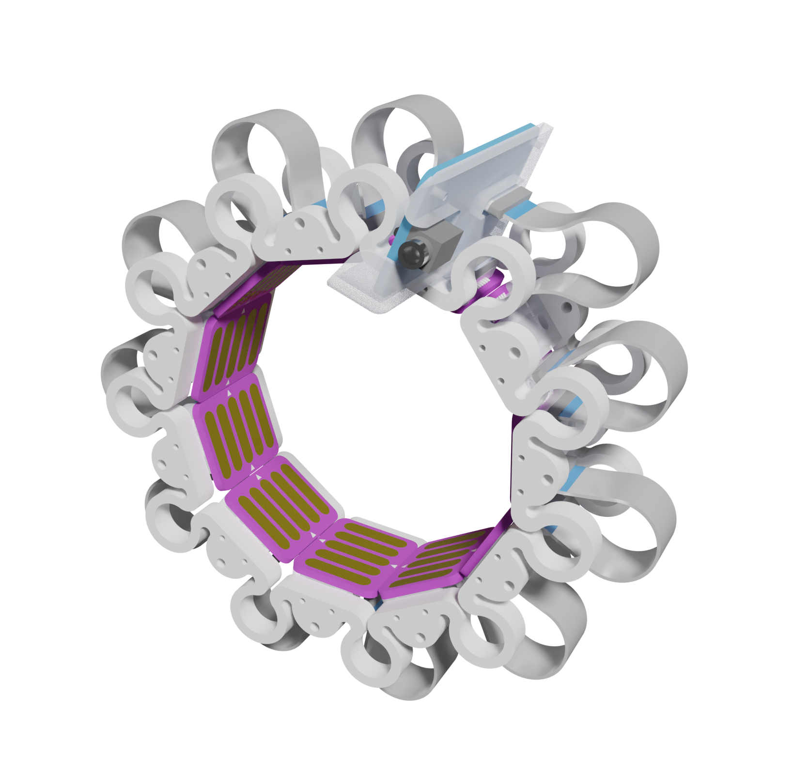
Introduction and Relevance to Theme:
Solution Teaser (High-Level Overview):
"A sleek, user-friendly hardware device that translates hand movements into speech and enhances prosthetic control."
Challenges Faced:
Speech Impairments: "Forced to rely on text messages, apps, or finding someone who understands sign language."
Prosthetics: "Current prosthetics restrict basic movements, failing to restore essential finger functionality."
Relevance of Addressing This:
"Promoting inclusivity and independence by breaking communication barriers and improving mobility solutions."
"A crucial step towards empowering individuals to engage fully in society."
Wrist Band

Slide 5
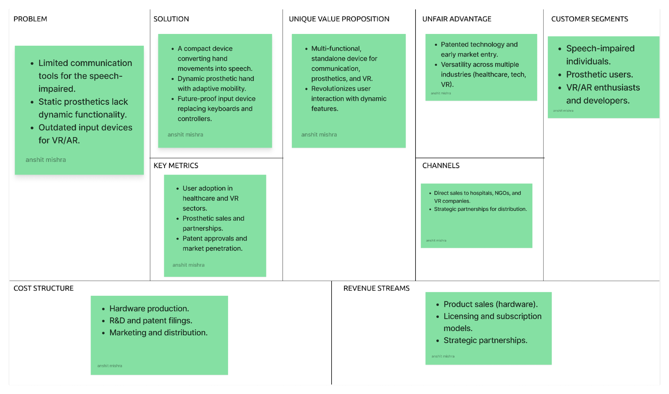
LEAN CANVAS

Slide 6
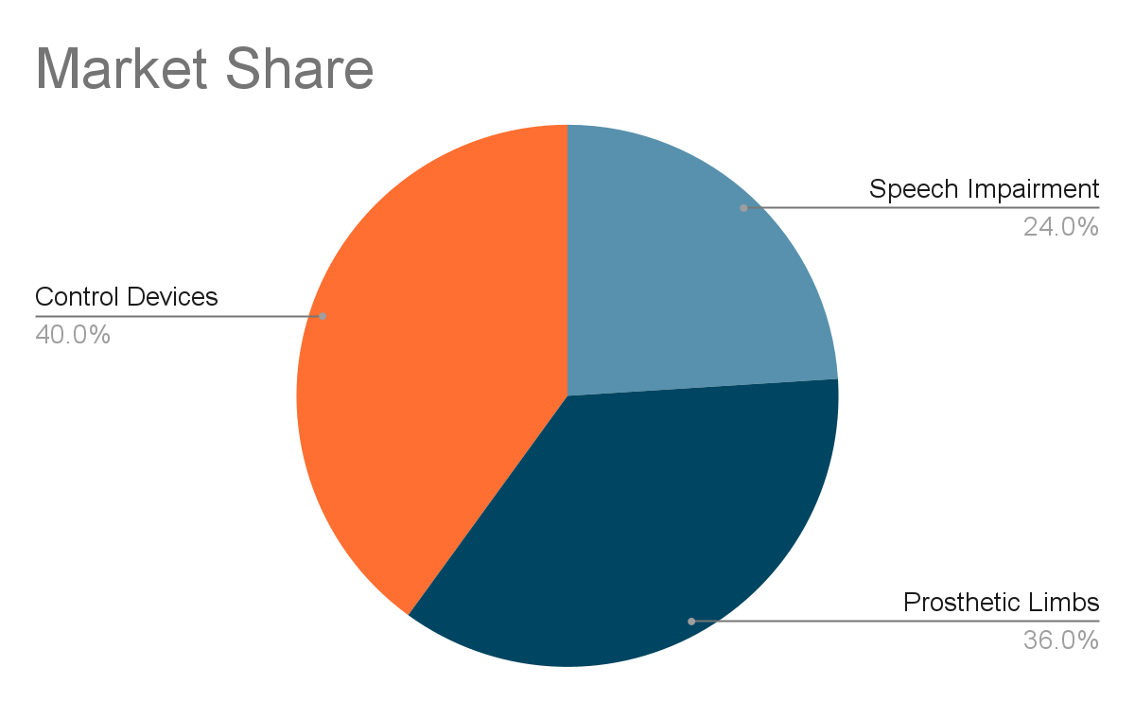
Market Opportunity
Serviceable Addressable Market (SAM)
Speech Impairment Devices: Targeting 500,000 individuals in India, focusing on urban and semi-urban areas with access to healthcare facilities and assistive technology.
Prosthetic Hands: 1 million potential users in India, prioritizing hospitals, rehabilitation centers, and NGOs that serve individuals needing advanced mobility solutions.
Control Devices: Penetrating 20% of the $163.1 million Indian keyboard market by offering innovative input devices for the growing VR/AR market.
Total Addressable Market
Speech Impairment: 1.2 million individuals in India (~1.2% of population) with speech impairment, globally millions more.
Prosthetic Limbs: 3.9–5 million individuals in India alone require prosthetics.
Control Devices (Keyboards): Indian market expected to generate $163.1 million by 2024, with global growth in VR/AR inputs.
How We Make Money
Product Sales: Wearable devices to users & institutions.
Licensing Fees: Patented tech to prosthetic & tech companies.
Subscription Model: Monthly/annual plans for advanced features.

Slide 7
Go to Market Strategy (GTM)
Where Will You Get in Front of Them?
Digital Channels:
Social media ads targeting speech-impaired and prosthetic communities (Facebook, Instagram, LinkedIn).
Dedicated website with educational content, testimonials, and a seamless e-commerce experience.
Partnerships:
Collaborate with hospitals, NGOs, and prosthetic manufacturers for product trials.
Partner with VR/AR companies for bundled offerings.
On-Ground Initiatives:
Host workshops and product demos in hospitals, rehabilitation centers, and tech expos.
Attend accessibility and tech conferences to reach early adopters.
Where Are Your Customers Looking Today and Finding Help?
Speech-Impaired Individuals:
Rely on sign language interpreters, basic communication devices, and mobile apps.
Seek help via NGOs, hospitals, and disability forums.
Prosthetics Users:
Explore traditional prosthetics through rehabilitation centers and online marketplaces.
Look for guidance from healthcare providers and support groups.
VR/AR Users:
Purchase controllers and input devices through e-commerce platforms like Amazon, Flipkart, and specialty tech stores.
Follow reviews, influencers, and tech forums.

Slide 8
Business Model
Source of Revenue
Product Sales – Direct sales of the hardware device to individuals, hospitals, NGOs, and VR/AR companies.
Licensing – Licensing our patented technology to prosthetic manufacturers and tech companies for integration into their products.
Subscription Model – Offering premium features or software updates via a subscription service, particularly for VR/AR applications and advanced prosthetic functionalities.
Investors viable business model in place
Direct Sales – High-margin sales of our hardware to a rapidly growing market (healthcare, prosthetics, VR/AR) ensures quick revenue generation and scalability.
Licensing Deals – Our patented technology unlocks massive potential for recurring income by licensing to prosthetic manufacturers and tech giants, allowing us to expand without heavy production costs.
Subscription Model – Ongoing software updates, premium features, and VR/AR integration create a continuous revenue stream, boosting customer retention and lifetime value.
Notes:
Our device is a versatile solution with far-reaching applications. First, it empowers individuals with speech impairments, enabling real-time communication through simple gestures. In the world of prosthetics, it provides precise control of prosthetic hands, allowing users to regain independence in tasks that current solutions can’t handle. Beyond healthcare, our device can revolutionize Virtual Reality and gaming, replacing traditional input devices and providing a more immersive experience. From healthcare to tech, this innovation is ready to redefine how people interact with the world.

Slide 9
Financials
Total Revenue:
Year 1 (2025): ₹15 lakh – Generated through pilot programs and initial sales.
Year 2 (2026): ₹75 lakh – Growth driven by partnerships and targeted marketing.
Year 3 (2027): ₹3 crore – Sustained by scaling production and entering global markets.
Total Customers:
Year 1 (2025): 1,000 customers (early adopters and pilot participants).
Year 2 (2026): 10,000 customers (expanding to Tier-1 and Tier-2 cities).
Year 3 (2027): 50,000 customers (national and global reach)
Total Valuation:
Year 1 (2025): ₹10 lakh – Based on early-stage development and pilot testing.
Year 2 (2026): ₹50 lakh – Scaling production and capturing a larger market share.
Year 3 (2027): ₹2 crore – National expansion and significant revenue growth.
Total Expenses:
Year 1 (2025): ₹12 lakh – Primarily R&D, prototype refinement, and marketing.
Year 2 (2026): ₹50 lakh – Increased production, staffing, and marketing.
Year 3 (2027): ₹1.5 crore – Focus on large-scale manufacturing and partnerships.
EBITDA (Earnings Before Interest, Taxes, Depreciation, and Amortization):
Year 1 (2025): ₹3 lakh – Early breakeven through cost control and initial sales.
Year 2 (2026): ₹25 lakh – Significant profitability with increased market penetration..

Slide 10
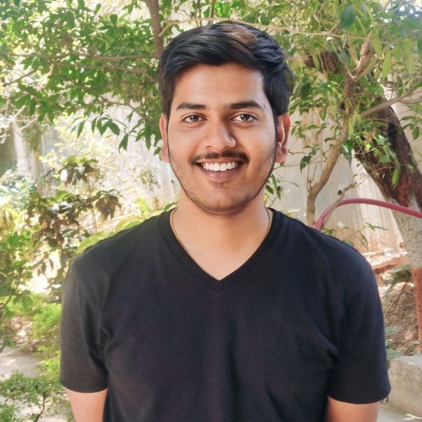
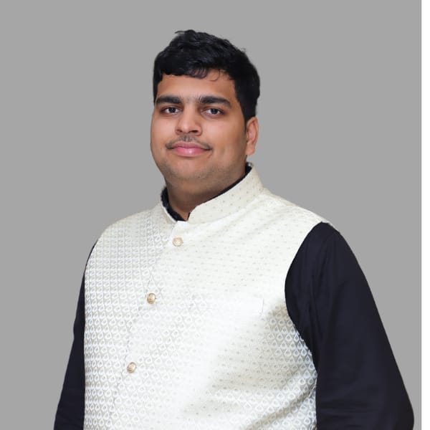

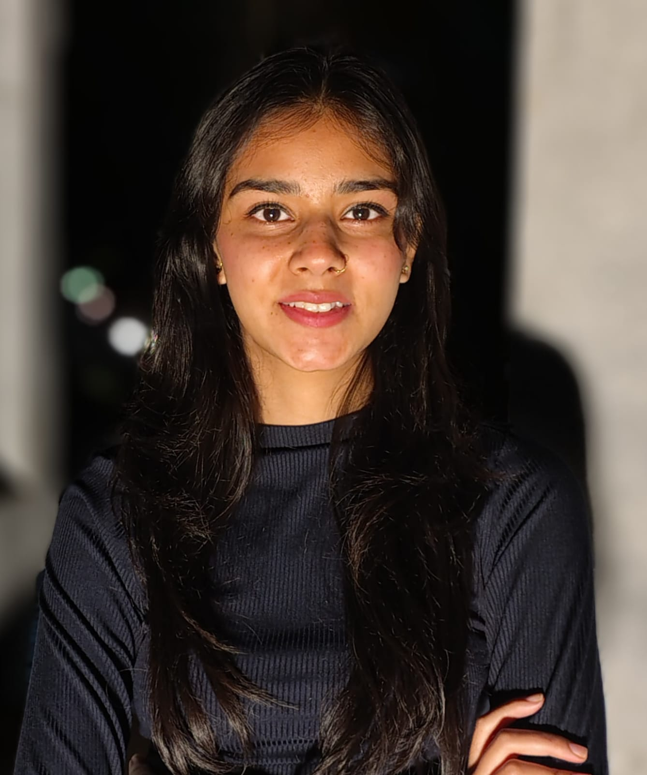
Team
Anshit Mishra
Satyam Agarwal
Tanishka Chowdhry Saxena
Sanchit Gupta
12

Slide 11

Thank You
Notes:
“Thank you for your time and consideration. We believe that with your support, we can transform the future of communication and mobility.”

